Slide 1

Building Business Intelligence Solution for The Syrian Ministry of Interior
Supervised by:
Dr. Mouhib Alnoukari
Prepared by:
Ahmad Yones
Oumama Nabaa
Ibrahim Hafez

Slide 2
Goal of the Project
Applying Analysis and Business Intelligence solutions concepts on the Ministry of Interior of Syria data, to improve the process of decision-making.
This project consists of implementing a business intelligence solution to the Ministry of Interior of Syria data, which increases decisions accuracy by providing accurate knowledge and easy-to-read reports to decision-makers.

Slide 3
Business Intelligence Phases
Identify End-User Requirements
Identify data source
1
2
Data Cleansing ETL (Extract, Transform, Load)
Analyze the Data
3
4
Visualize the Data
5

Slide 4
Identify End-User Requirements
In this step, we put efforts in understanding the business questions which provided by the business owner (The Ministry) in our case, then select the useful columns that affect the decision-making.
Business questions are:
What is the relation between number of violations and the quarters of year ?
What is the relation between number of violations and License City?
What is the relation between city of violation and city of license?
How many numbers of violation paid after 1 month?
How many numbers of violations paid in the same year?
How many SP we get from a specific biller?
What is the avg of discounted points?

Slide 5
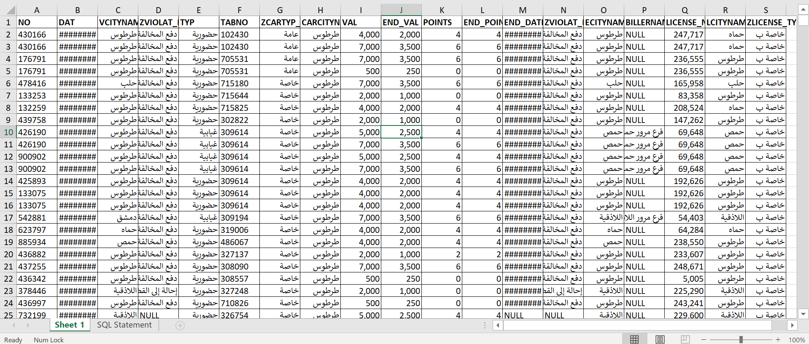
Identify the Data Sources
We had the data directly from the Ministry of Interior provided by our supervisor Dr. Mouhib Alnoukari. It’s an Excel file with 402540 records, 17 columns, and a size of 45.7MB.

Slide 6
ETL
Our biggest challenge was the data cleansing phase; we got into so many problems due to the low-quality data and the massive amount of missing values, failed .Entries, and data ambiguity.

Slide 7






Tools and Technologies
used in
ETL
Microsoft SQL Server Management Studio
Python
Microsoft SQL Server
Pandas
Power BI
Excel

Slide 8
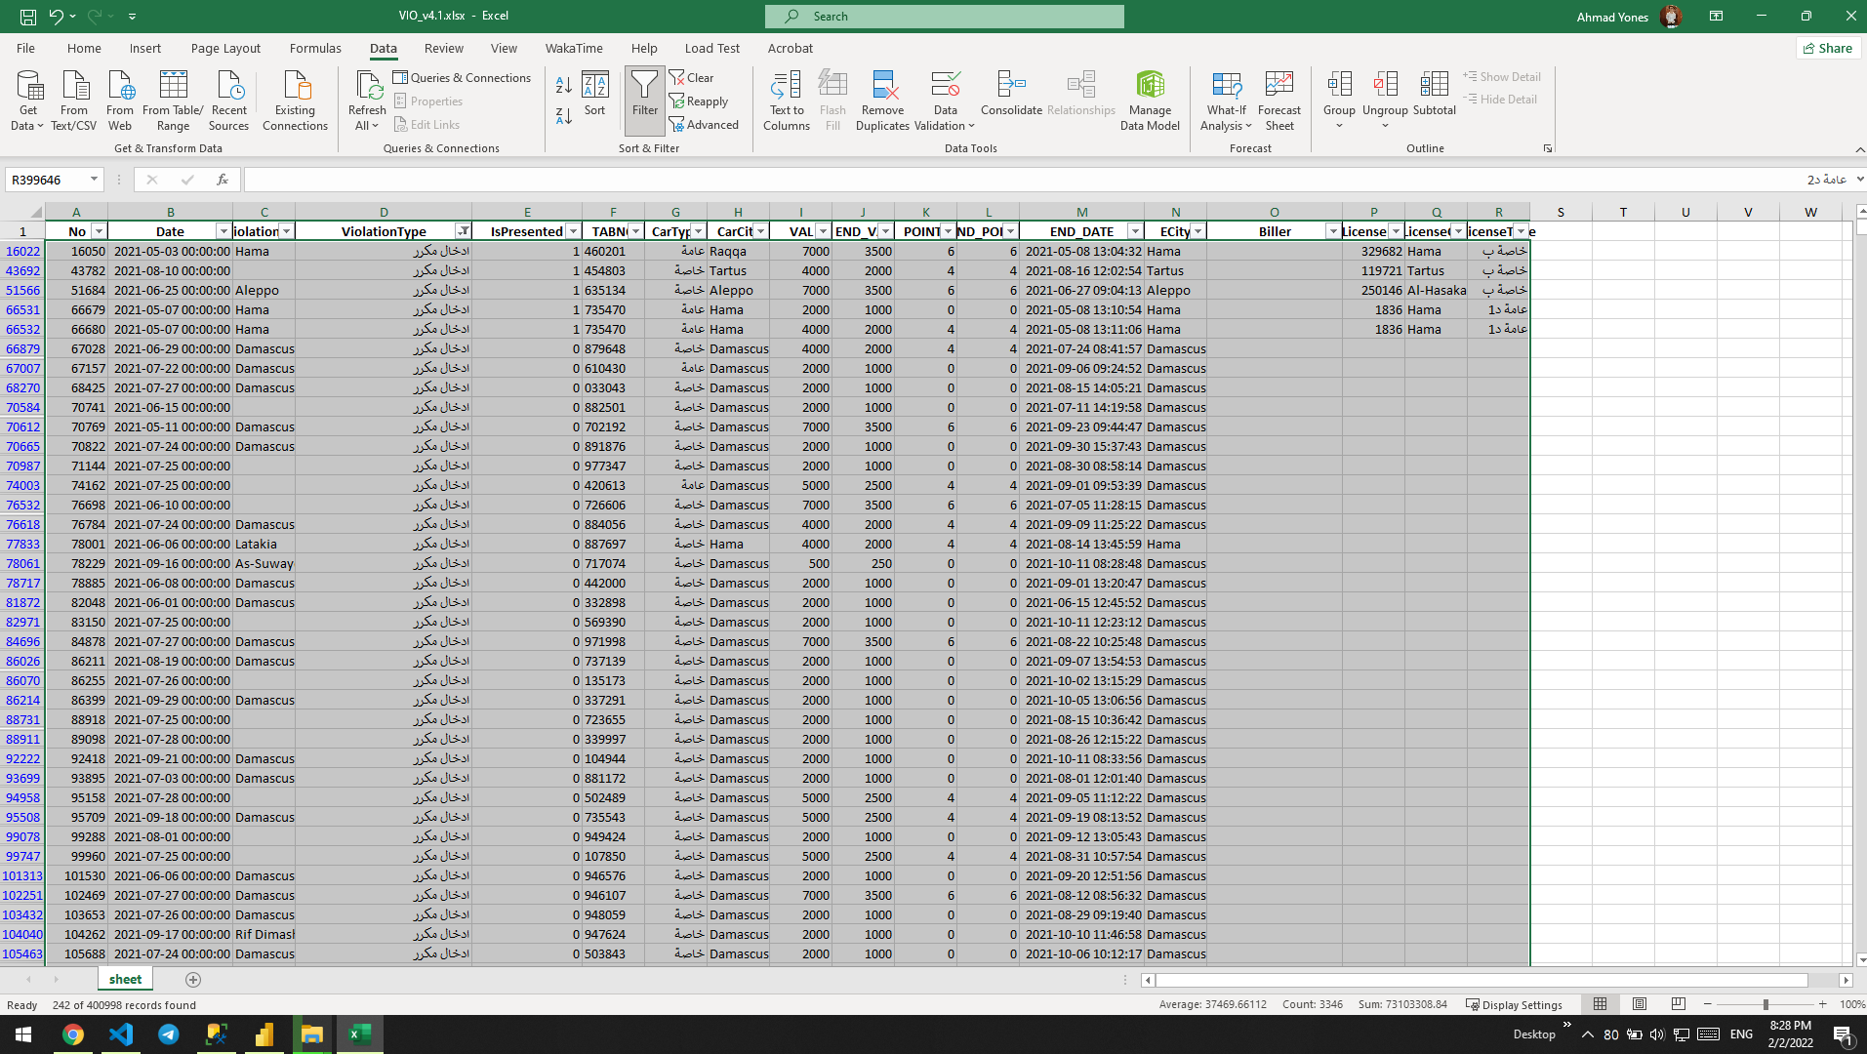
Data cleansing phase
Dropping records that consist of duplicated entries, wrong entries, conflicts, and ambiguous meanings.
Duplicated Entries

Slide 9
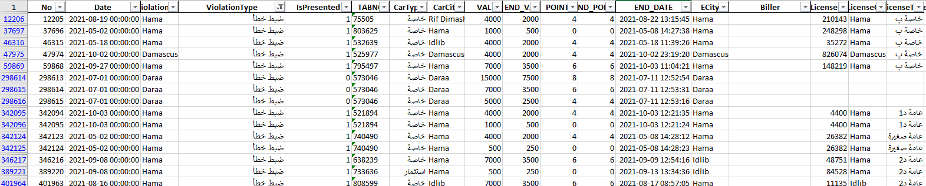
Data cleansing phase
Wrong Entries

Slide 10
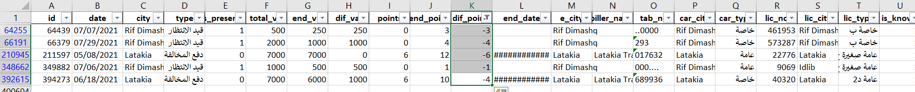
Data cleansing phase
Conflicts

Slide 11
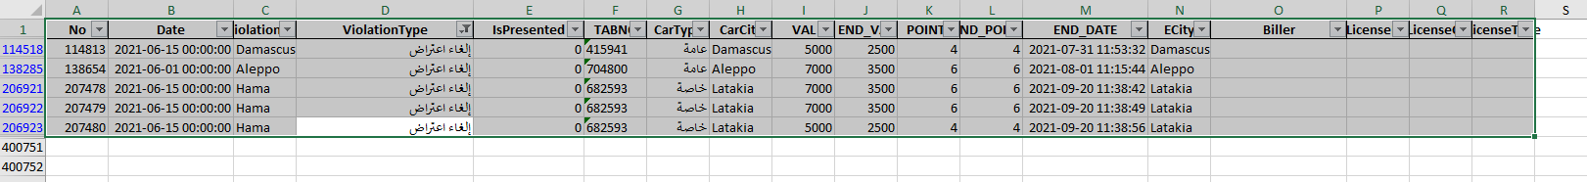
Ambiguous Meaning
Ambiguous Meaning

Slide 12
Data cleansing phase
We added a new column to map between null values that we found in primary keys in “LicenseNO” column and the new column (new primary key). (Every null value takes a specific value)
We needed to loop over 150000 x 85000 elements, takes O(n2) and it’s an impossible solution so we applied the dictionary data structure property. (Pandas library takes the DataFrame and covert it to a dictionary) in order to use the hashing ability that dictionary provides so we can assign a new primary key to the License Dimension distinct values in O(n).

Slide 13
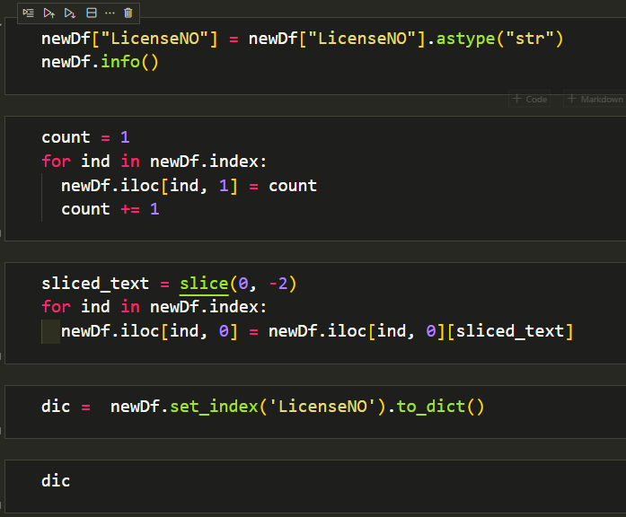
Data cleansing phase

Slide 14
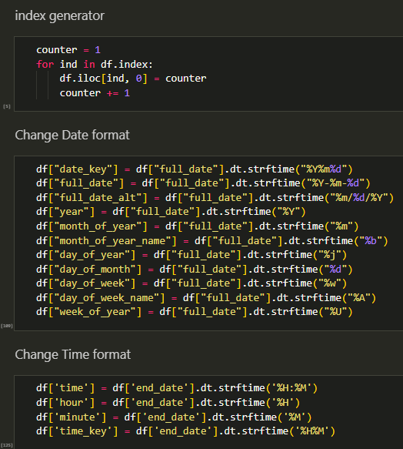
Data cleansing phase
Table Modification

Slide 15
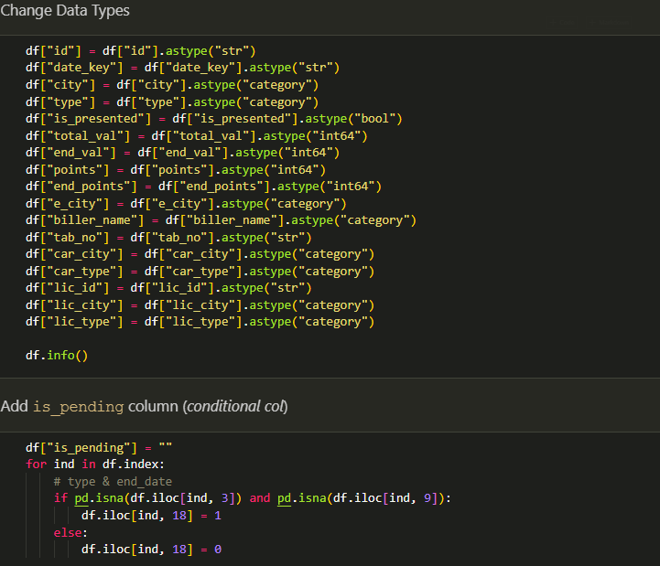
Data cleansing phase

Slide 16
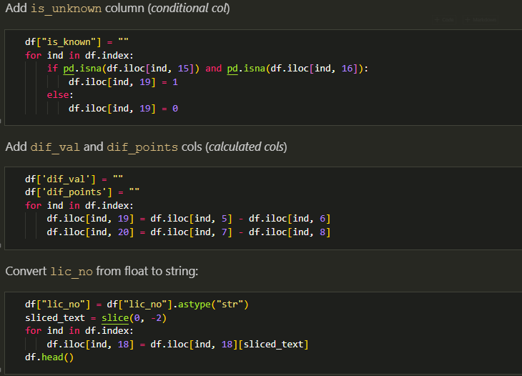
Data cleansing phase

Slide 17
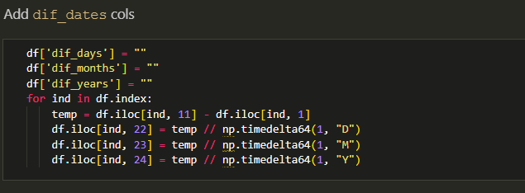
Data cleansing phase

Slide 18
Loading Data
We had some conflicts in data types while loading data.
Columns:
1- CarKey
2- CarTabNo
3-CarCity
4-CarType

Slide 19
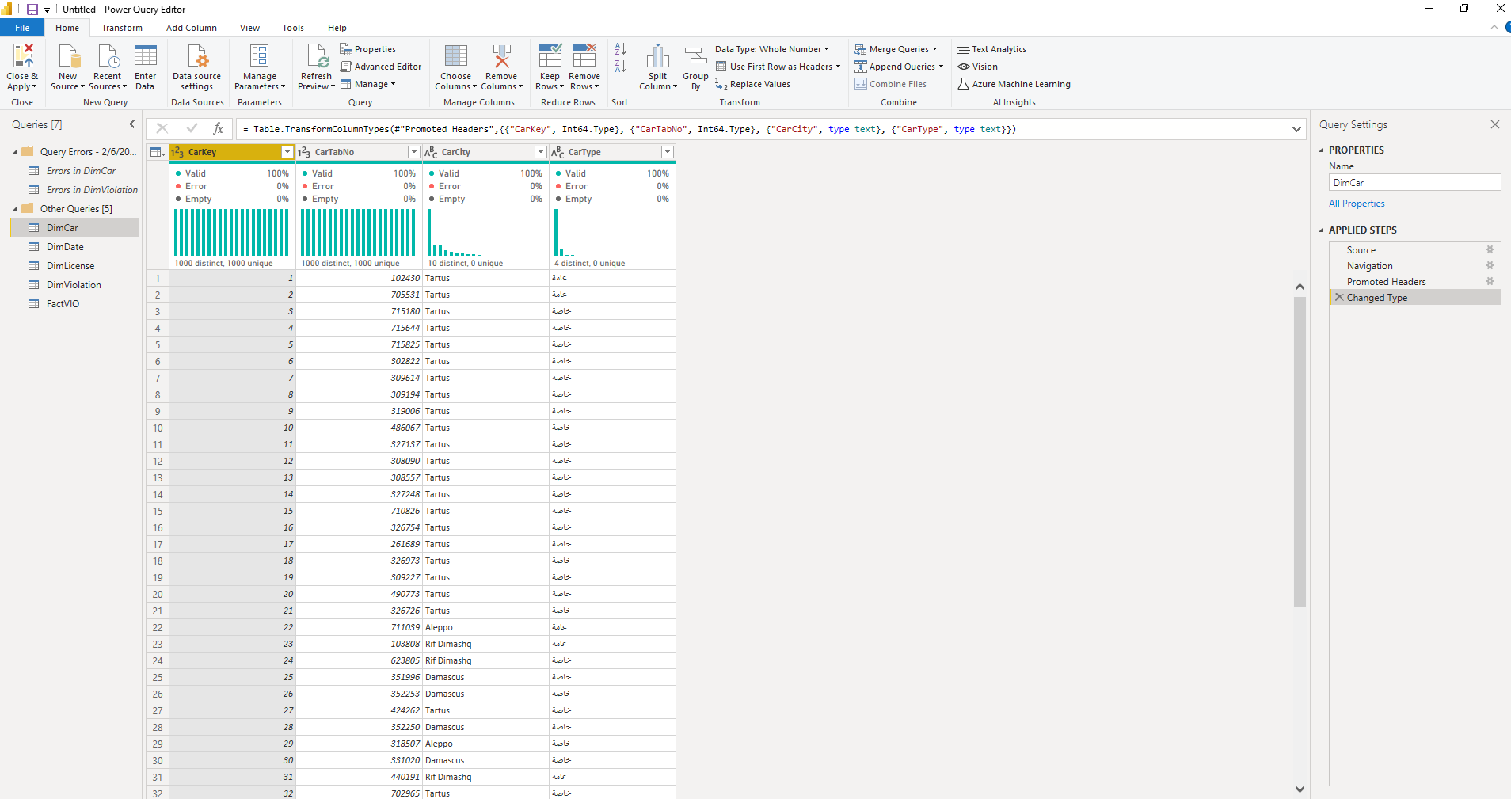
Loading Data

Slide 20
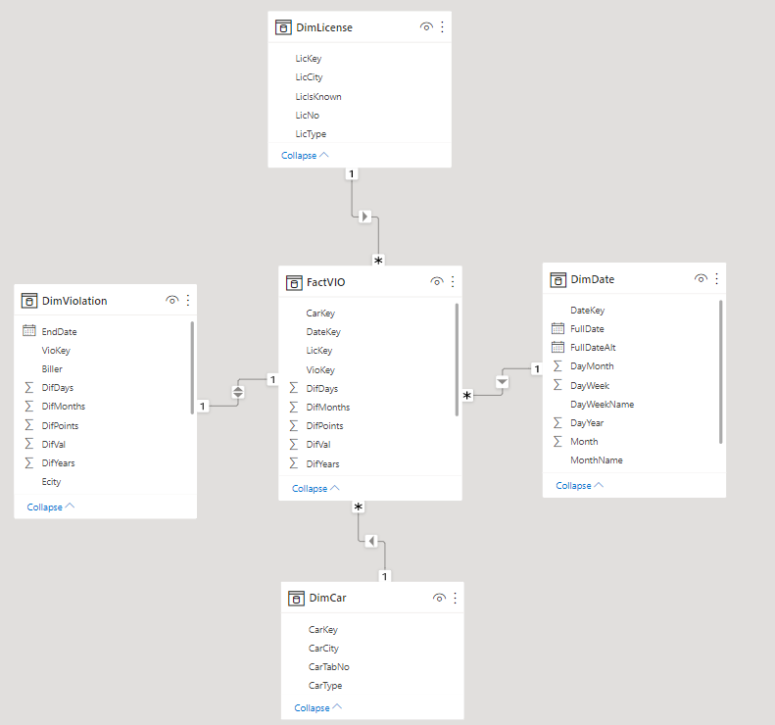
Design the Data Model

Slide 21
Dashboard
Demo

